Slide 1
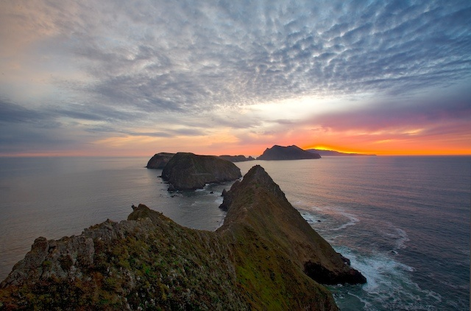
Notes:
Let’s travel west now from Anacapa …

Slide 2
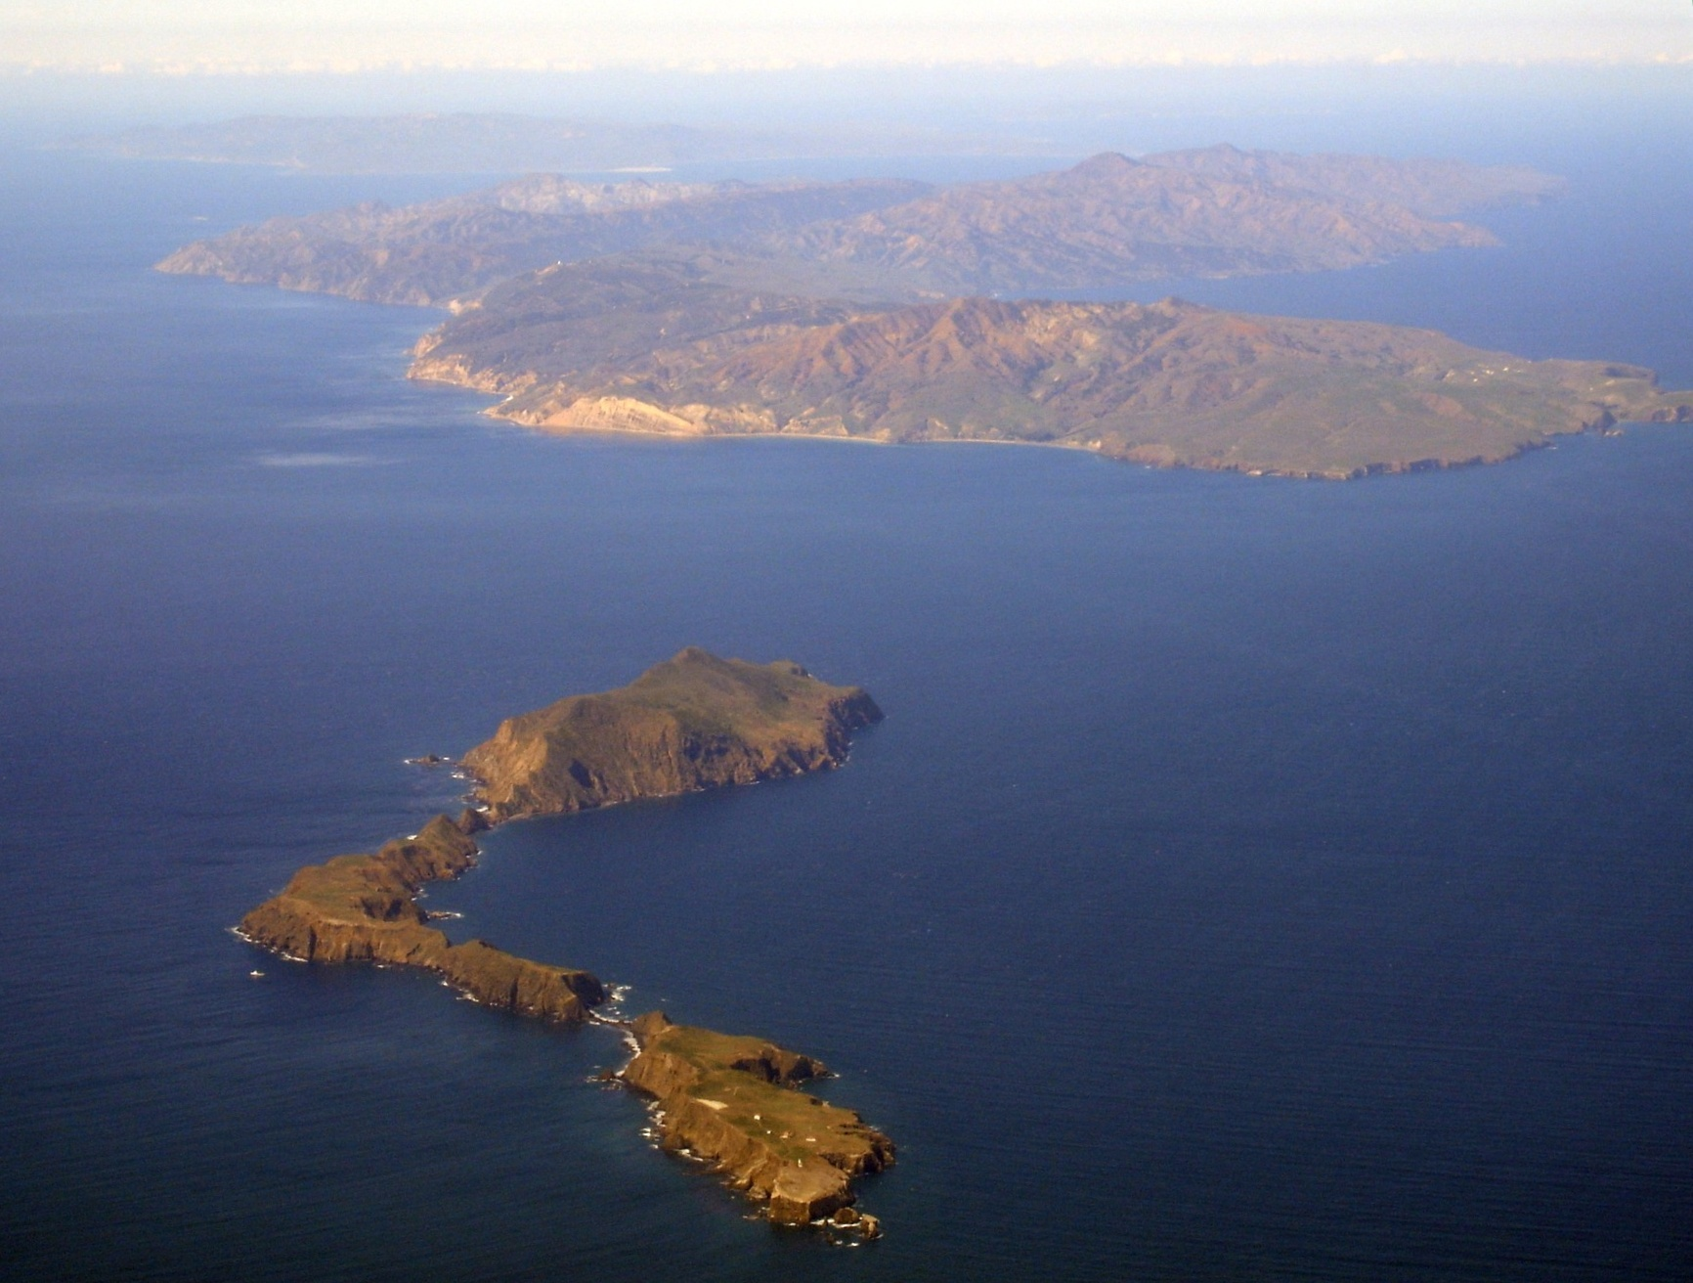
Santa Cruz
Notes:
… to Santa Cruz …

Slide 3
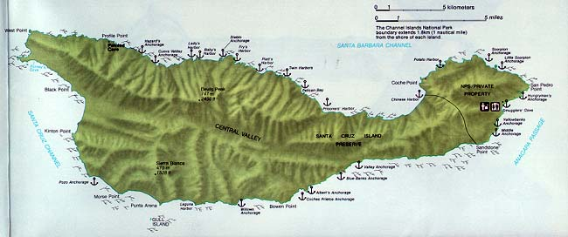
SANTA CRUZ
Notes:
… the largest channel island. Santa Cruz has a lot of interesting geology to see, but let’s start with the most obvious which lies along the island’s Central Valley.

Slide 4
Notes:
You don’t have to be a trained geologist to see that the Central Valley follows an almost perfectly straight line.

Slide 5
Santa Cruz Island Fault
Notes:
No doubt you have already suspected that this is a fault. What comes as some surprise, however, is the sense of displacement on this fault. Unlike the San Andreas and its parallel sister faults in the continental borderland which are right lateral, ….

Slide 6
Santa Cruz Island Fault
Notes:
… the Santa Cruz Island Fault is left lateral.

Slide 7
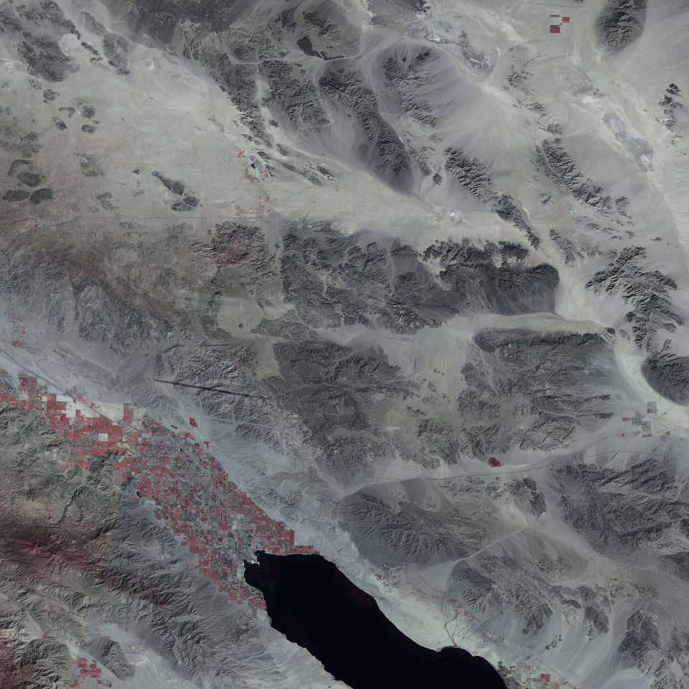
ECSZ
PMF
BCF
SAF
Notes:
Recall from our study of Joshua Tree National Park that left lateral faults can form in association with right lateral faults due the clockwise rotation that such displacement imparts on blocks that lie between major right lateral strike slip faults.

Slide 8
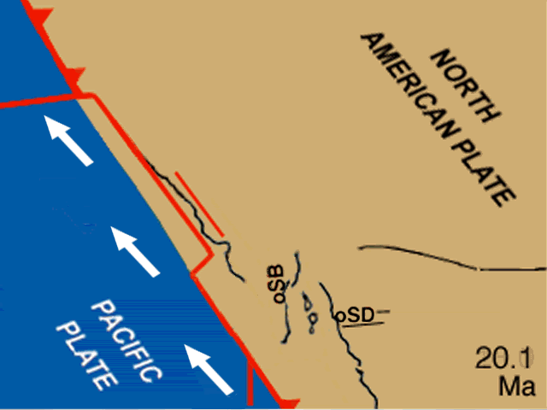
Notes:
What is surprising here is that the amount of rotation of Santarosae is about 90 degrees! This interpretation is supported by paleomagnetic evidence that also places Santarosae much further south 20 million years ago, to a position off of San Diego and northern Baja California. Note the gaps that open in the continental borderland in the wake of rotating Santarosae. These regions are likely to induce decompression melting in the underlying mantle and thereby form basaltic magma.

Slide 9
Geologic Map of Santa Cruz Island
Notes:
Displacement on the Santa Cruz Island Fault must be significant because it separates the island’s geology into two distinctly different parts. Shown in red here are Miocene volcanic rocks related to those found on Anacapa Island and Santa Barbara Island. They only outcrop north of the fault while Oligocene, Eocene and Paleocene sedimentary rocks (bluish greens), Jurassic plutonic rock (pink) and Pre-Jurassic metamorphic rocks (olives) only occur south of the fault. Miocene sedimentary and volcaniclastic rocks lie on both sides of the fault.

Slide 10
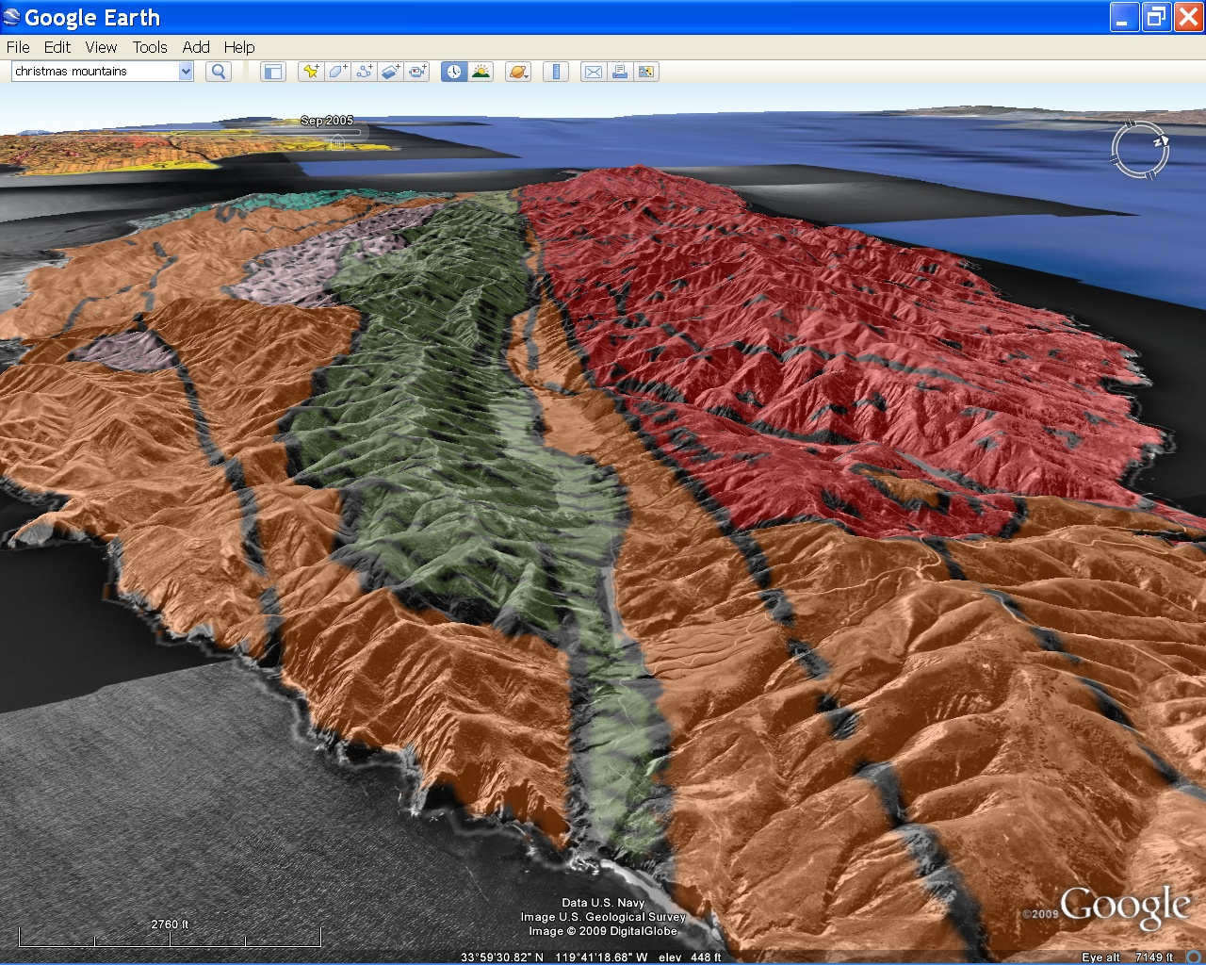
Older
Younger
Notes:
In general, the fault separates older rocks in the south from younger rocks in the north.

Slide 11
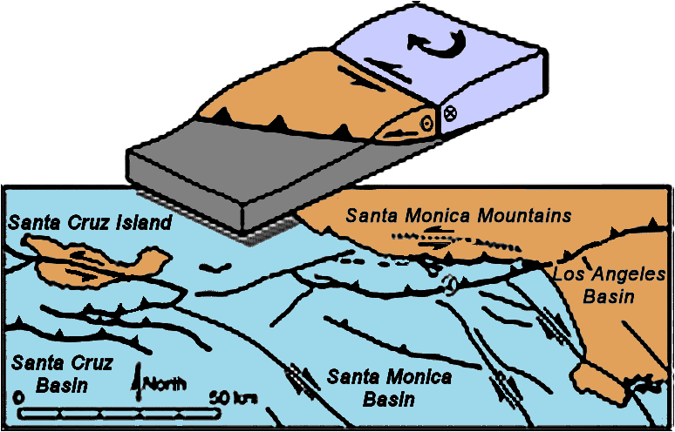
Santa Cruz Island Fault
Anticline
Thrust Fault
Notes:
Older rocks are exposed south of the Santa Cruz Island Fault because that area was uplifted along a broad anticline that formed as the block of crust that formed Santa Cruz Island and the Santa Monica Mountains …

Slide 12
Santa Cruz Island Fault
Anticline
Thrust Fault
UPLIFT
Notes:
… was thrust over …

Slide 13
Santa Cruz Island Fault
Anticline
Thrust Fault
SUBSIDENCE
Notes:
… the block of crust that subsided to form the Santa Cruz, Santa Monica and Los Angeles Basins.

Slide 14
Santa Cruz Island Fault
Anticline
Thrust Fault
Notes:
The Santa Cruz Island Fault formed as the overthrust block fractured to accommodate the greater amount of uplift near the somewhat upturned near-surface portion of the thrust fault. Although some vertical motion occurs along the Santa Cruz Island Fault, …

Slide 15
Santa Cruz Island Fault
Anticline
Thrust Fault
Notes:
… most of the displacement along the Santa Cruz Island Fault is left lateral …

Slide 16
Santa Cruz Island Fault
Anticline
Thrust Fault
Notes:
… due to clockwise rotation of crustal blocks above the thrust fault …

Slide 17
Santa Cruz Island Fault
Anticline
Thrust Fault
Notes:
… induced by the regional right lateral shear stress.

Slide 18
Santa Cruz Island Fault
Anticline
Thrust Fault
Thrust Faults
Notes:
But why did a roughly 200 km-long system of thrust faults develop in the first place? Surely the great length of this fault system implies something more regional in extent than transpression along a bend in one of the right lateral strike slip faults. Well yes, and no. Actually these thrust faults are the result of transpression, but on a grand scale because the fault that bends to create the transpression here is the mighty San Andreas itself!

Slide 19
Transverse Ranges
Notes:
Watch the animation again, this time notice how as Baja California breaks away from mainland Mexico a big bend develops on the San Andreas Fault in the vicinity of the present Transverse Ranges.

Slide 20
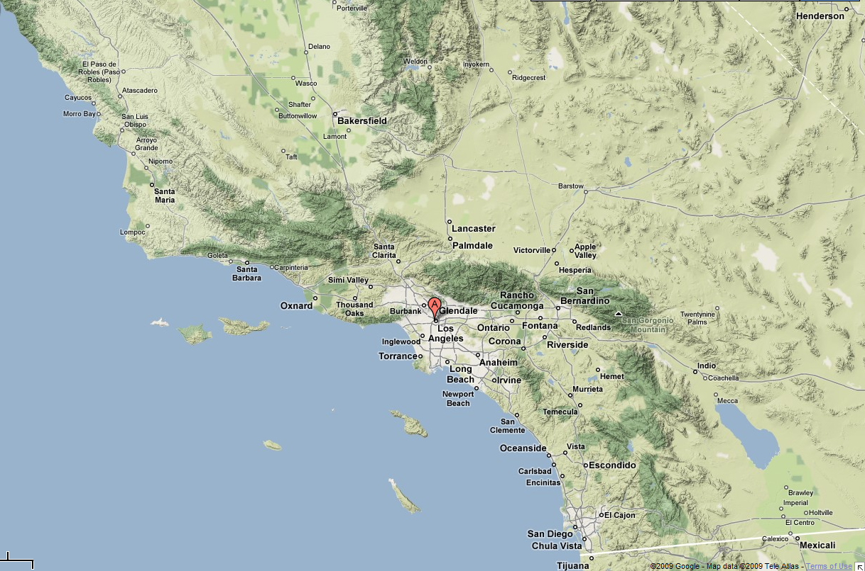
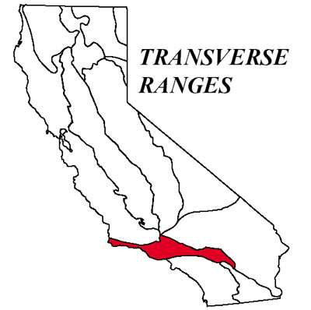
Transpression
Notes:
So the big bend in the San Andreas Fault produces transpression on a regional scale …

Slide 21
Notes:
… which explains the numerous thrust faults in the area responsible for the uplift of the Transverse Ranges, …

Slide 22
Notes:
… the Santa Monica Mountains and Santarosae. Bear in mind that all this thrusting and mountain building is relatively recent and that Santa Cruz Island had a rich geologic history before it was uplifted.

Slide 23
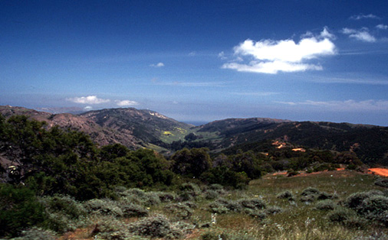
North
Volcanics
Schist, quartz diorite, various sedimentary rocks
Santa Cruz Island Fault
Notes:
That pre-uplift history is recorded in the various Miocene and older strata which recall are exposed on the south side of the island.

Slide 24
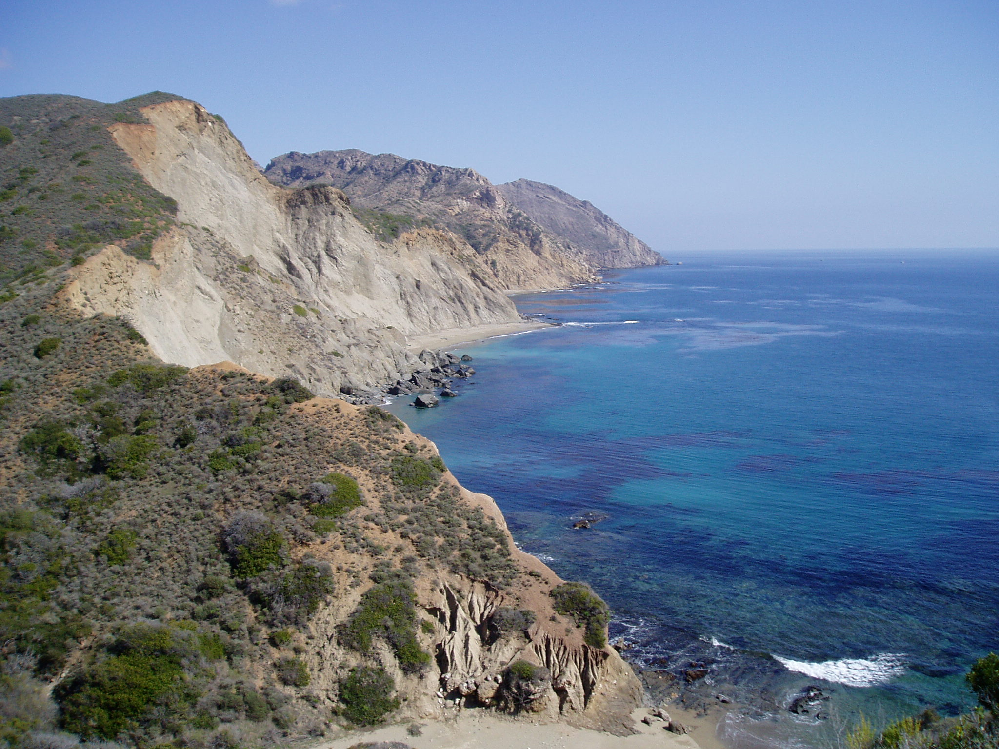
Miocene volcaniclastic rocks
Notes:
Most of these are ash-rich, Miocene volcaniclastic rocks, …

Slide 25
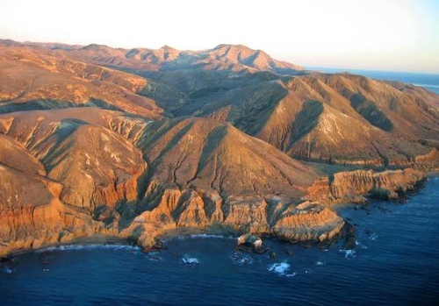
Paleocene to Miocene sedimentary rocks
Notes:
… but at the southwest end of the island a thick sequence of Paleocene through Miocene sedimentary rocks is exposed.

Slide 26
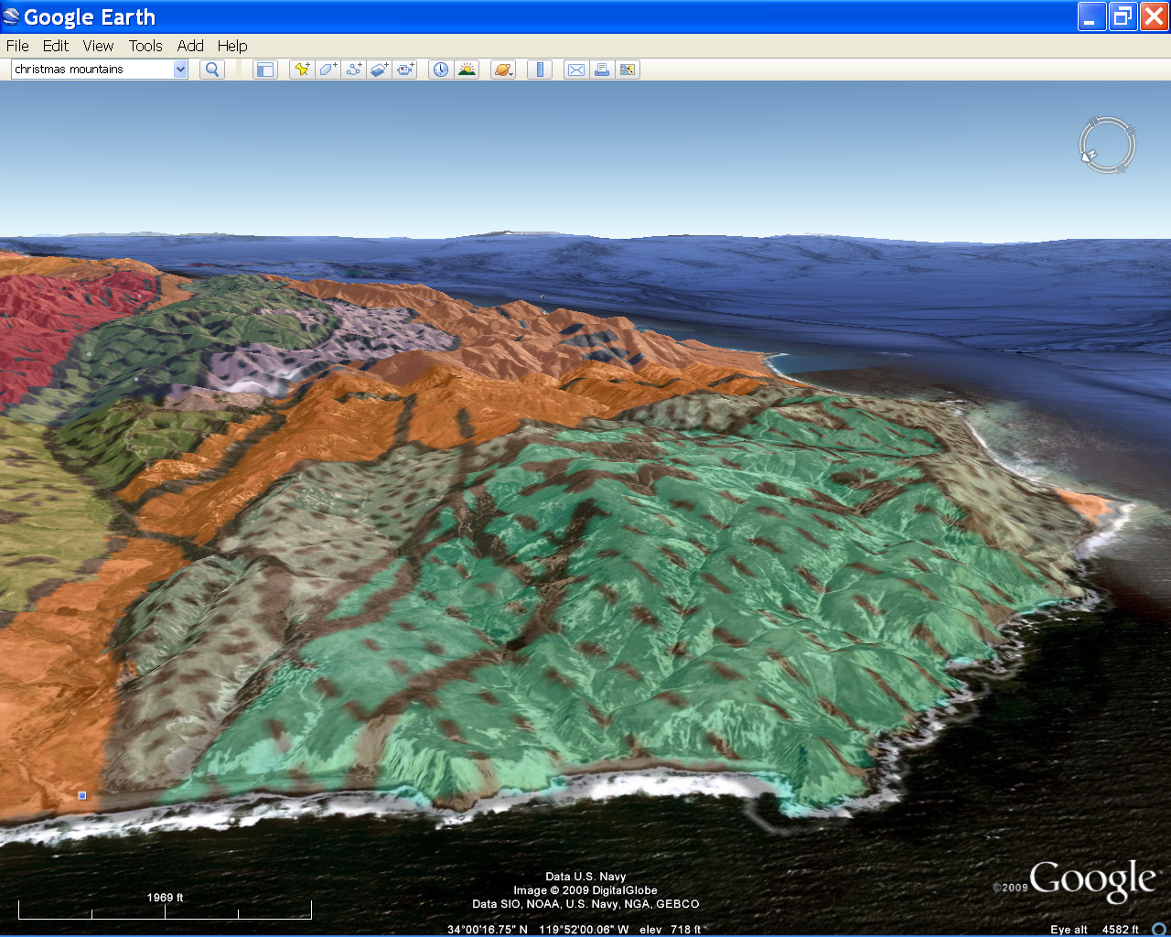
Notes:
Here’s a broader view of the area in Google Earth with the geologic map overlay.

Slide 27
Miocene
Miocene
Oligocene
Oligocene
Eocene
Eocene
Notes:
Notice the pattern of older rocks in the middle to younger rocks on the outside. What type of geologic structure does this pattern indicate?

Slide 28
Miocene
Miocene
Oligocene
Oligocene
Eocene
Eocene
Notes:
An anticline. There are folds like this throughout the area, but this one is especially pretty. It exposes a sequence of sedimentary rock including shale, sandstone, conglomerate and breccia that records …

Slide 29
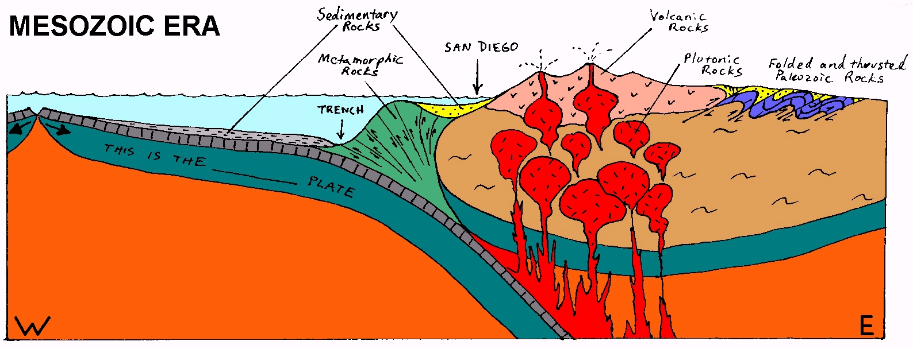
Forearc basin sedimentation
Notes:
… a very general change in forearc basin deposition from deep water marine sediment in the Mesozoic, …

Slide 30
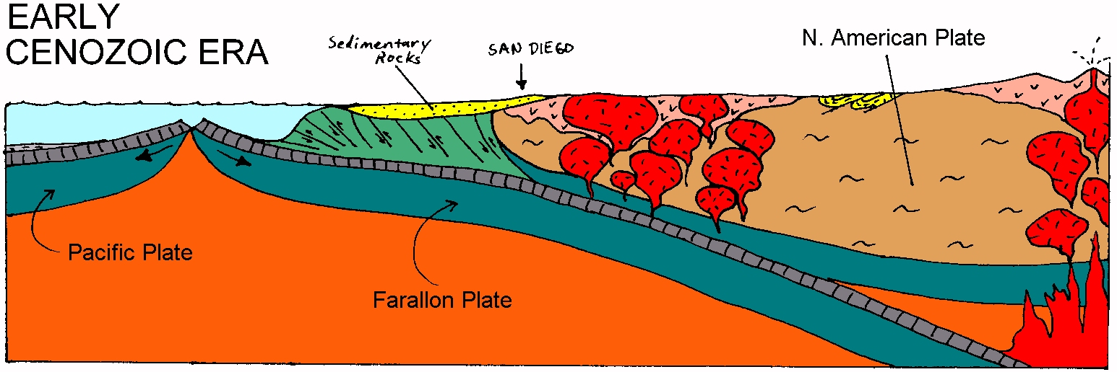
EPR approaches, forearc basin becomes shallower and more terrestrial
Notes:
… to shallower marine and more terrestrial sediments as the East Pacific Rise approached the trench and the Mesozoic volcanic arc eroded. Notice that the forearc basin sediments are deposited directly on top of the accretionary wedge mélange.

Slide 31
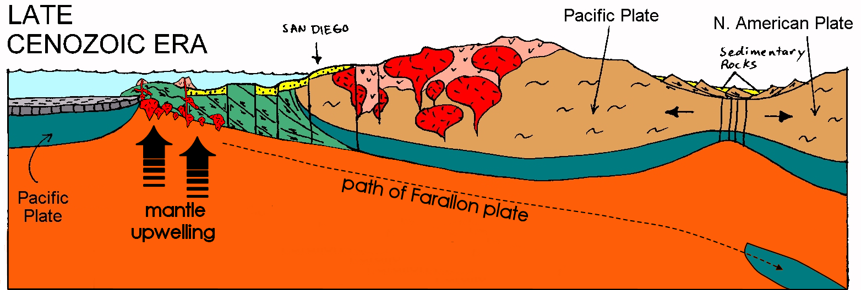
Forearc basin sediments eroded
Notes:
In the Miocene, the forearc basin sediments will be completely eroded along transpressional ridges - down to the underlying mélange.

Slide 32
Forearc basin sediments preserved
Notes:
But in transtensional basins, the forearc basin sediments will be preserved.

Slide 33
Source for San Onofre Breccia
Miocene San Onofre Breccia derived from uplifted mélange.
Notes:
Areas of exposed mélange shed a jumble of assorted rock types into the adjacent transtensional basins, which deposits on top of the older forearc basin sediments as the San Onofre Breccia.

Slide 34
San Onofre Breccia
Miocene
Miocene
Oligocene
Oligocene
Eocene
Eocene
Notes:
San Onofre Breccia is exposed at the base of the Miocene strata on both sides of the anticline.

Slide 35
San Onofre Breccia
Miocene
Miocene
Foreland basin strata
Notes:
It covers the forearc basin strata which have been pushed up in the anticline here.

Slide 36
San Onofre Breccia
Near Point
Miocene
Foreland basin strata
Notes:
On the far right is “Near Point”…

Slide 37
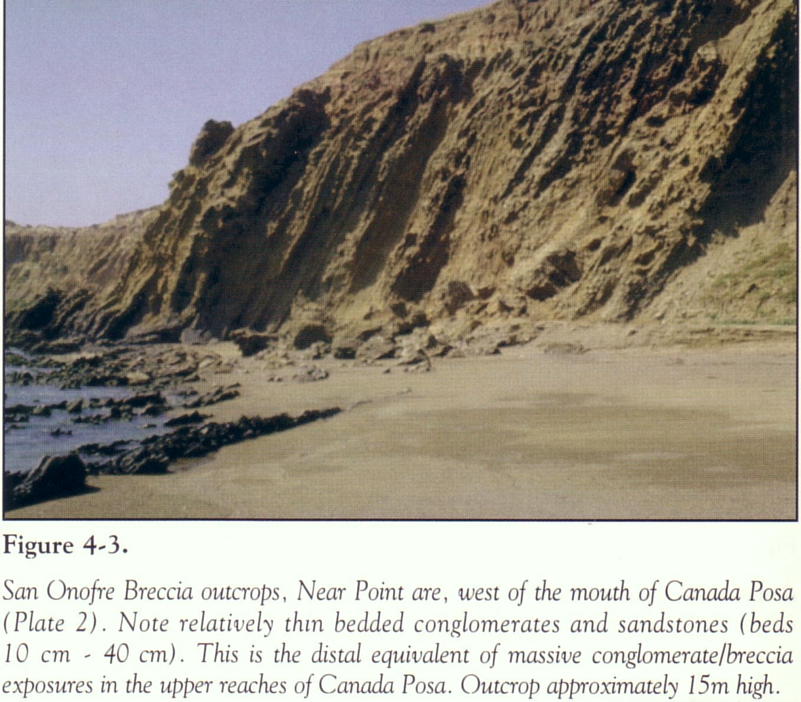
Notes:
… where you can see the San Onofre Breccia steeply tilted towards the ocean – away from the axis of the anticline.

Slide 38
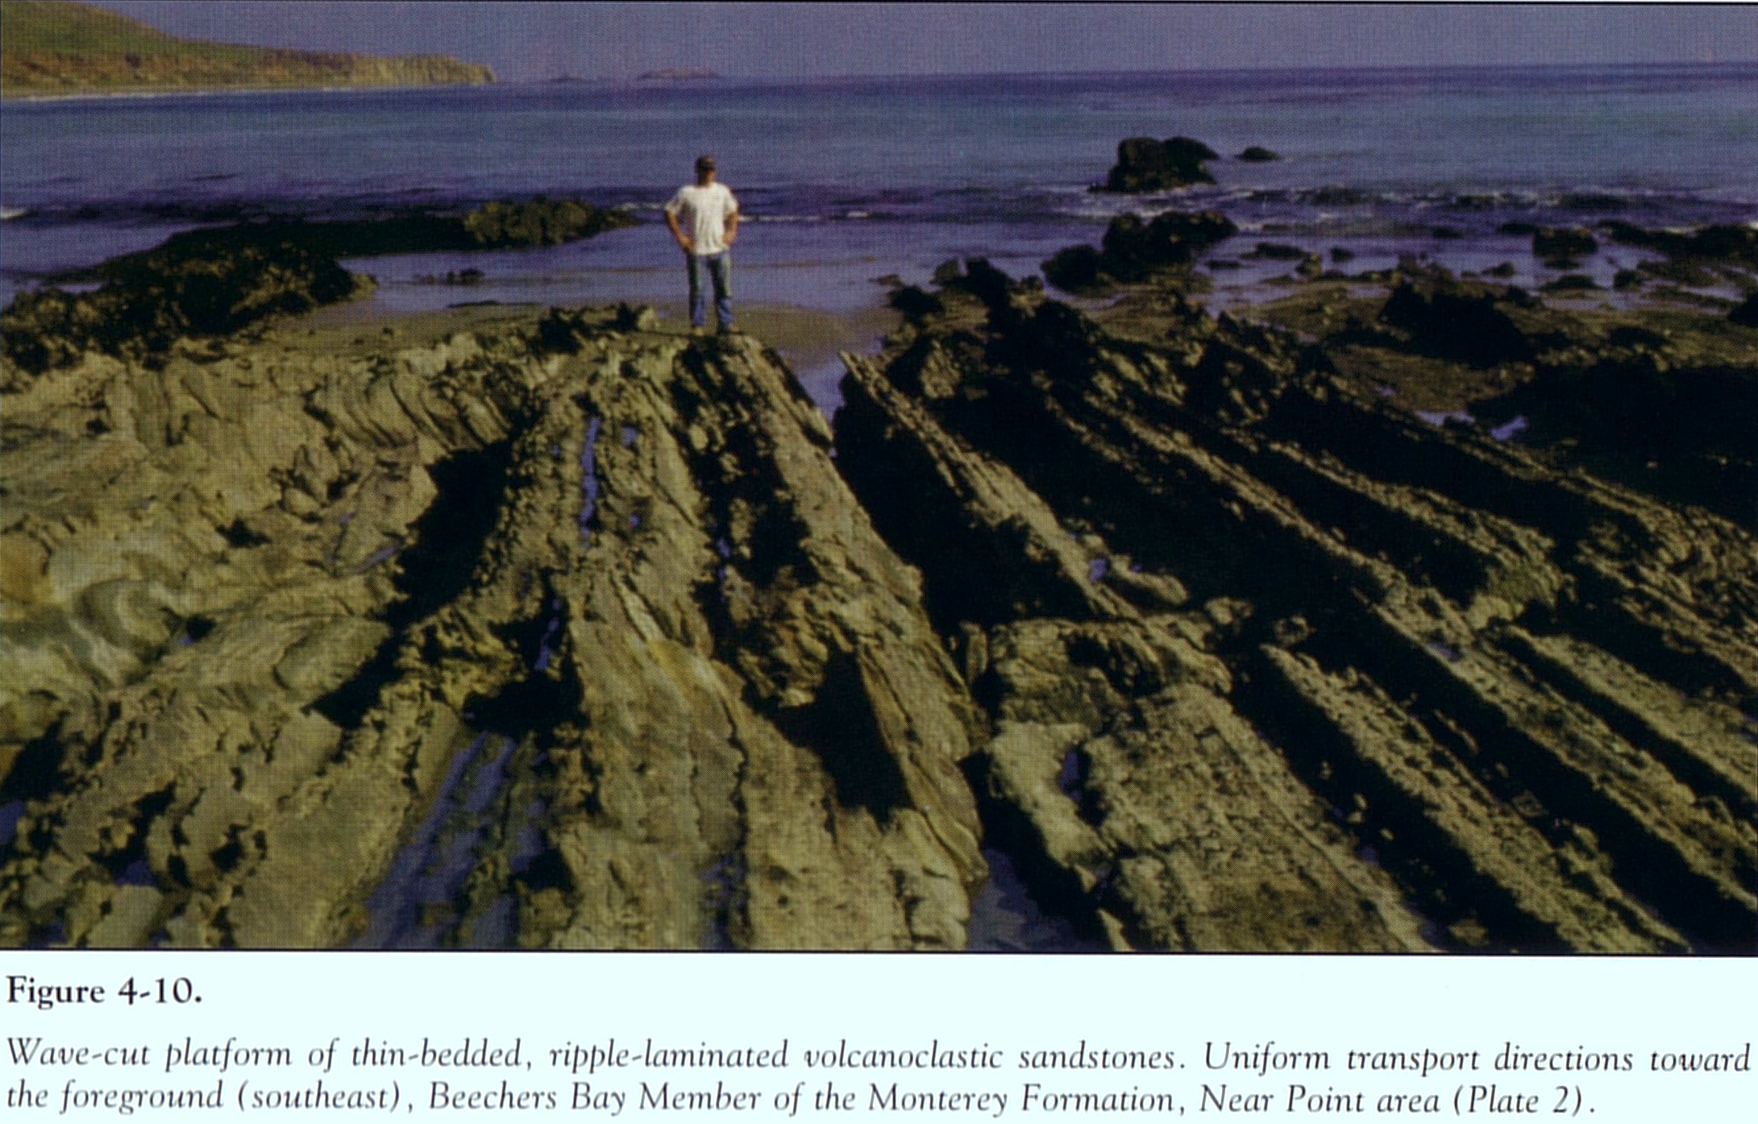
Notes:
Further out on the point you can see a nice wave-cut platform which exposes the slightly younger Monterey Formation. The Monterey Formation is the most widespread sedimentary unit in California. For the most part it represents the filling of the transtensional basins with marine sediments. But remember that transtension was accompanied by volcanism, so the Monterey Formation has a volcanic component. Here we see the Beechers Bay Member of the Monterey Formation which is a volcaniclastic sandstone. Younger parts of the Monterey Formation also have a volcanic component but, as we will soon see, intriguingly different from that of the Beechers Bay Member. They would be exposed to the right of the photo (older strata dips towards younger strata), …

Slide 39
Near Point
Notes:
… but Near Point does not extend far enough into the ocean to see them.

Slide 40
Miocene
Miocene
Oligocene
Oligocene
Eocene
Eocene
Notes:
However, we can look for them on the other side of the anticline …

Slide 41
Geologic Map of Santa Cruz Island
Notes:
… which is pretty much the rest of the island.

Slide 42
Geologic Map of Santa Cruz Island
Monterey Fm.
Blanca Fm.
Notes:
The Monterey Formation is exposed north of the Santa Cruz Island fault while the related Blanca Formation (which is probably just a facies of the Monterey) is exposed to the south. The Monterey Formation north of the fault is similar to that found elsewhere in California.

Slide 43
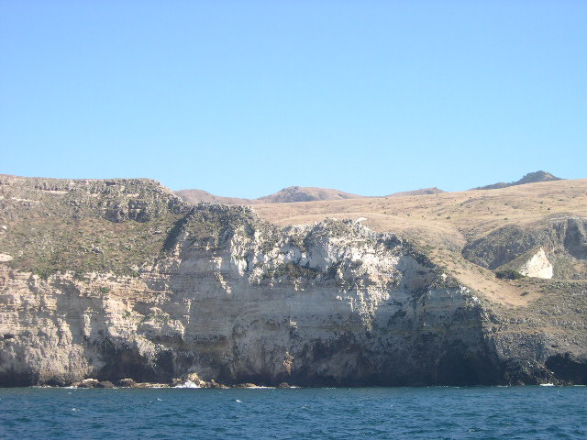
Santa Cruz Island
Monterey Shale
Notes:
It is a fine-grained shale. The distinctively white color …

Slide 44
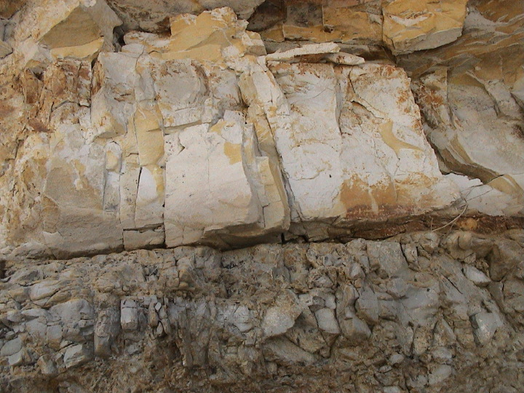
Typical Monterey Shale in Santa Barbara
diatomaceous
Notes:
… comes from the presence of diatoms, which are microscopic plant plankton that make shells of silica.

Slide 45
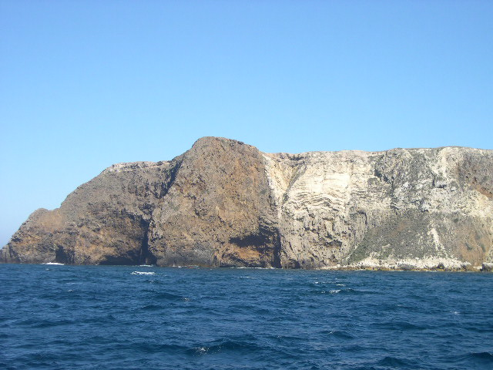
Contact between volcanics and Monterey Shale
Notes:
Along the island’s northeast shore there are some beautiful contacts exposed between the Monterey Shale and the Miocene volcanic rocks.

Slide 46
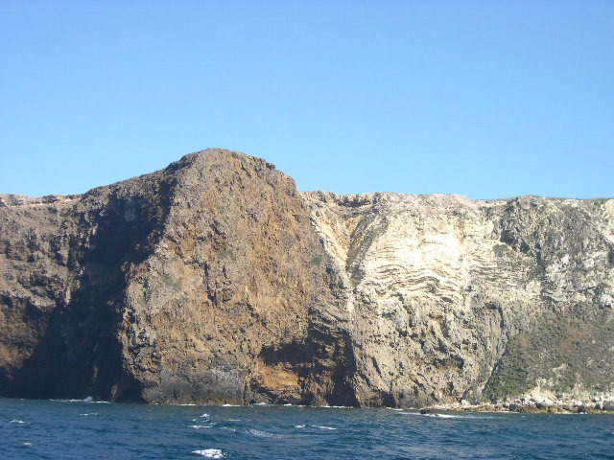
Notes:
A closer look shows that the bedding in the Monterey Shale is crumpled a bit, but generally horizontal, whereas the contact with the volcanic rocks is nearly vertical. You may suspect that this relationship indicates that the contact is a …

Slide 47
Fault
Notes:
… fault, and you would be correct. Using the law of cross-cutting relationships, you may also suspect that the fault is younger than the layers of Monterey Shale which terminate against it, but this is where you’d be wrong. The Monterey Shale is younger than the fault! Remember that the principle of lateral continuity allows for strata to terminate against the margins of their depositional basins without violating the law of cross-cutting relationships because obviously a basin is older than the sediments which fill it. What you’re seeing here is the Monterey Shale filling a fault-bordered transtensional basin.

Slide 48
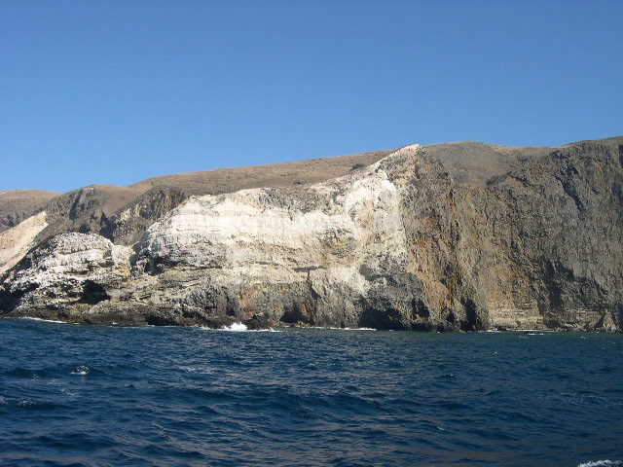
Faulting creates restricted basins
Notes:
Such fault-bounded basins sheltered the Monterey Shale from the influx of clastic continental sediment such that only ash, diatoms and pelagic clay deposited within them. Another important concept related to deposition within these basins is that for diatoms to flourish, and surely that is the case here, they must be fertilized. Since diatoms need silica to make their shells, and dissolved silica is generally a scarce commodity in the ocean, the addition of silica to the ocean can trigger massive diatom blooms. Now here comes the cool part:

Slide 49
Ash fertilizes diatoms
Faulting creates restricted basins
Notes:
That silica came from ash derived from volcanism related to the formation of the transtensional basins that are now filled with diatoms! I love it when so many geologic components come together like that. Remember, no rock is an accident. To be clear, the fertilizing ash did not derive from the relatively mafic volcanics you see in this photo, but rather from somewhat younger, more felsic eruptions. In general, Miocene volcanism became more felsic through time as the hot decompression-produced basaltic magma melted the silica-rich rocks at the base of the continental crust. The diatoms, quite literally, bring that felsic volcanism to life.

Slide 50
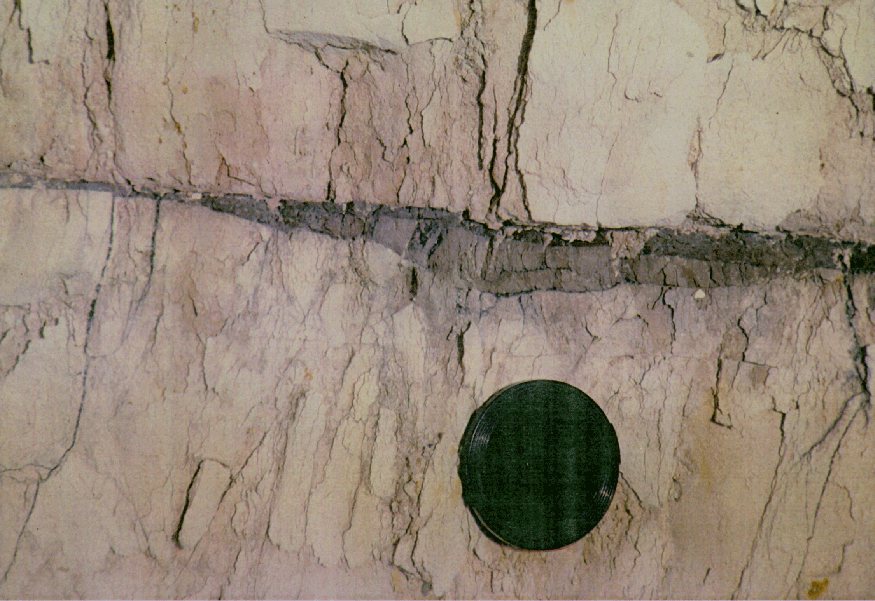
Hydrocarbons in Monterey Shale
Notes:
The organic matter in diatoms can be converted into hydrocarbons if the right amount of heat and pressure is applied. Those conditions often exist where the Monterey Shale is buried deeply in down-folded basins.

Slide 51
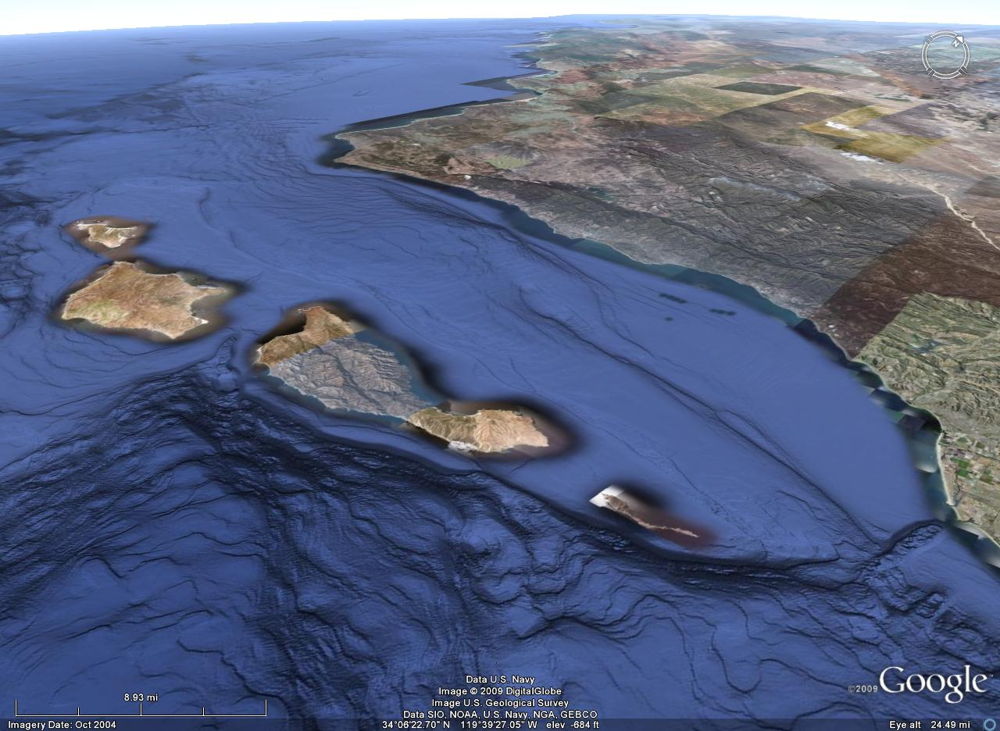
Santa Barbara Channel
Notes:
And that’s exactly what happened in the Santa Barbara Channel.

Slide 52
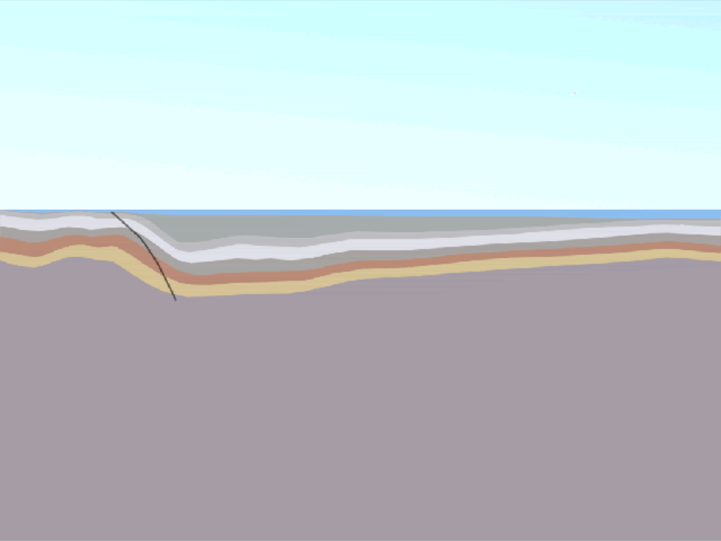
North
South
Santa Barbara Channel
Notes:
As this region was compressed, …

Slide 53
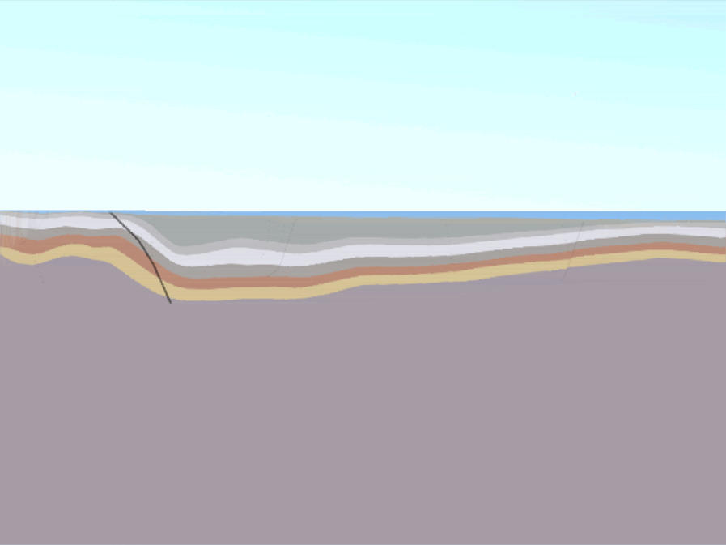
North
South
Santa Barbara Channel
Notes:
… the Santa Barbara Channel buckled under …

Slide 54
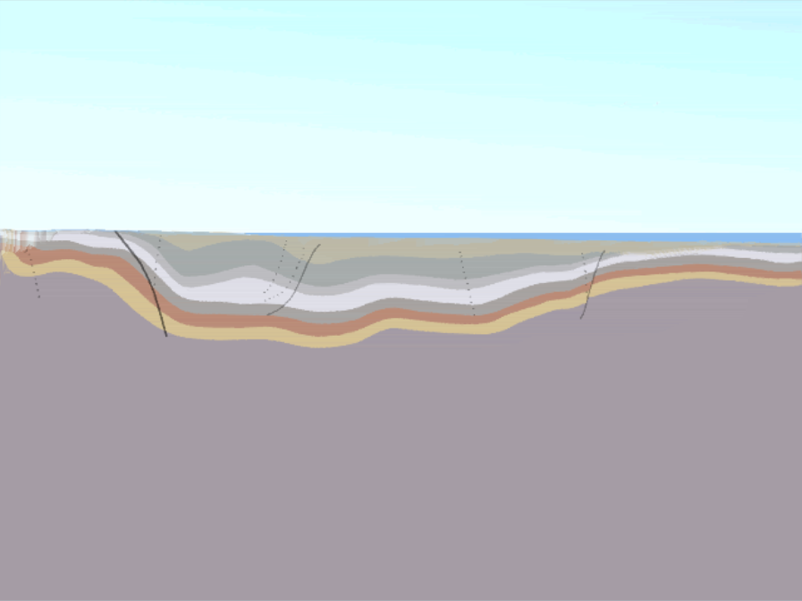
North
South
Santa Barbara Channel
Notes:
…

Slide 55
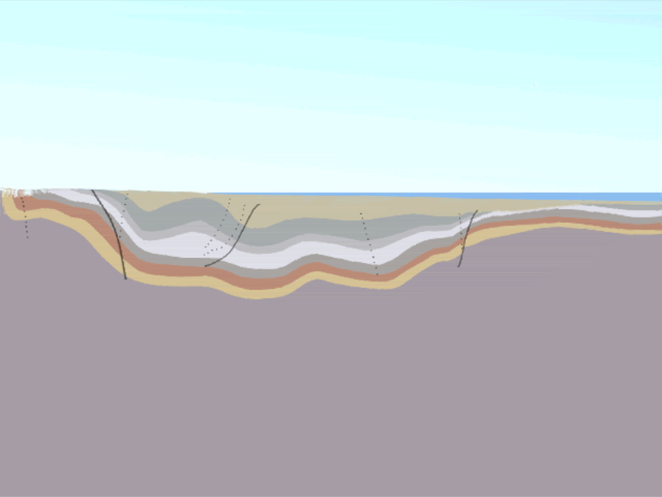
North
South
Santa Barbara Channel
Notes:
…

Slide 56
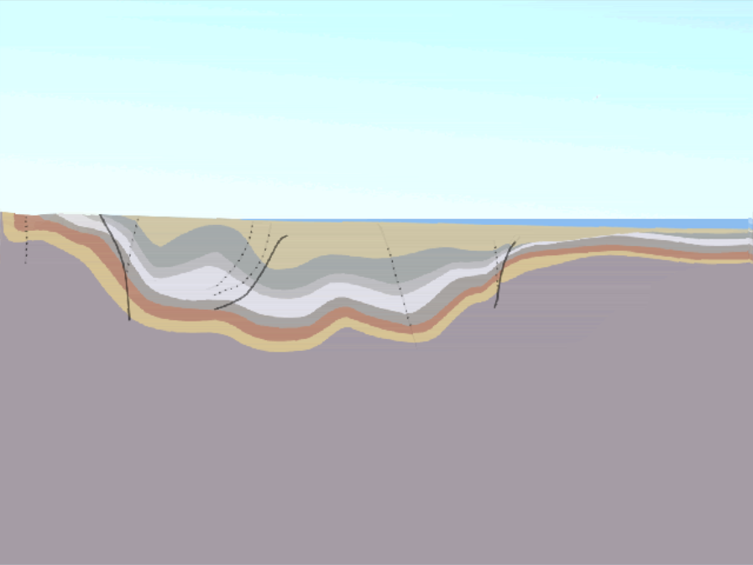
North
South
Santa Barbara Channel
Notes:
… and filled with a thick sequence of sediments, …

Slide 57
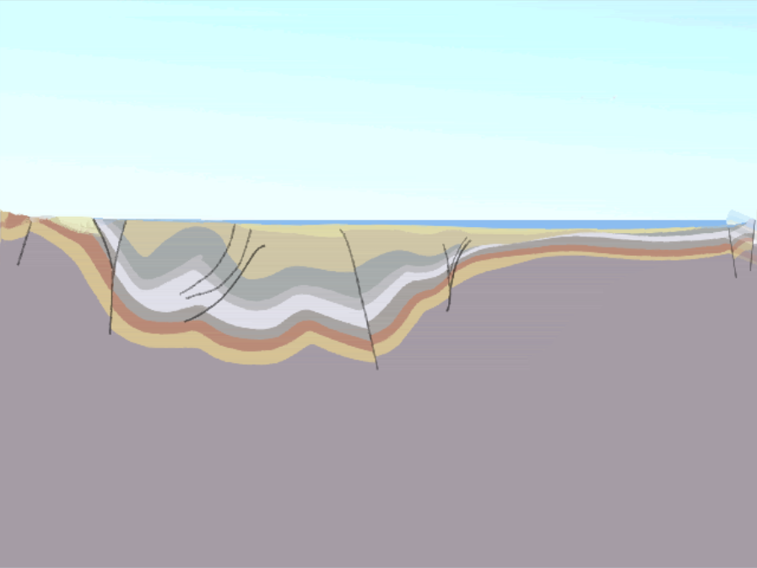
North
South
Northern Channel Islands
Notes:
… while the northern Channel Islands …

Slide 58
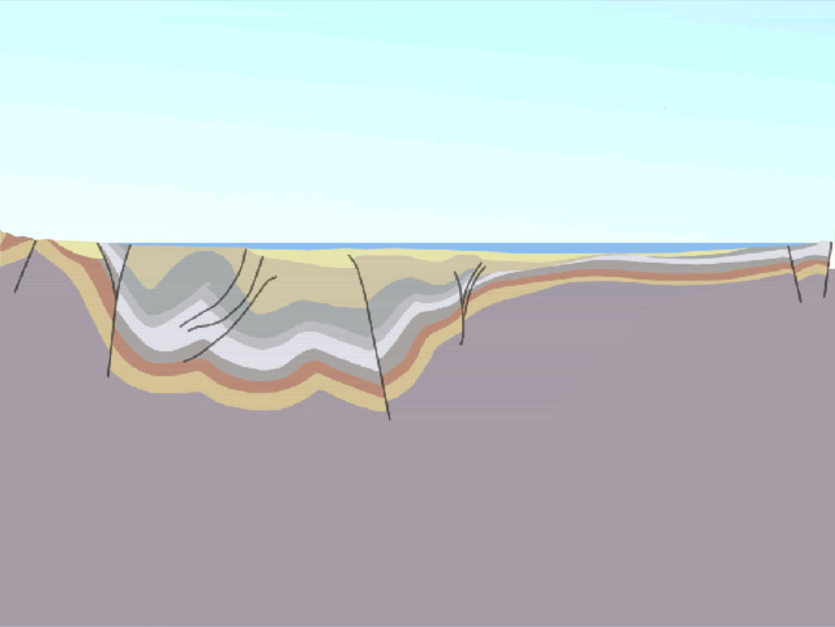
North
South
Northern Channel Islands
Notes:
… were thrust and folded upwards.

Slide 59
North
South
Oil Rig
Notes:
The Monterey Shale is the source rock for most of the petroleum …

Slide 60
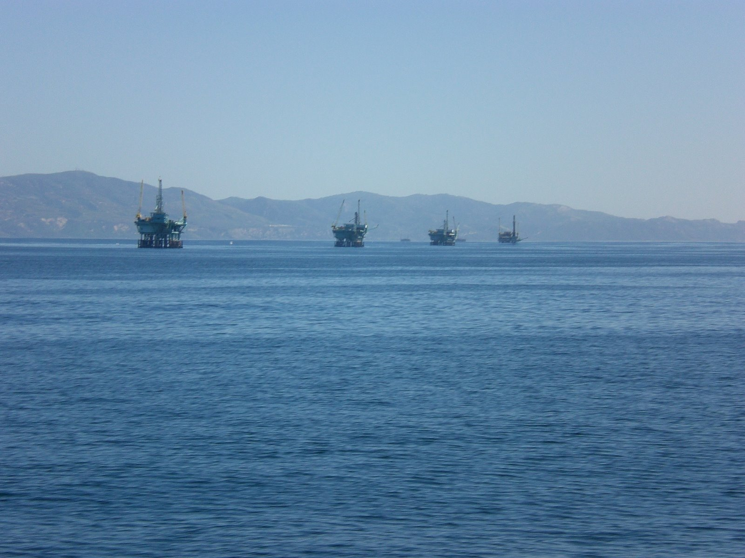
Oil rigs in Santa Barbara Channel
Notes:
…. pumped from California.

Slide 61
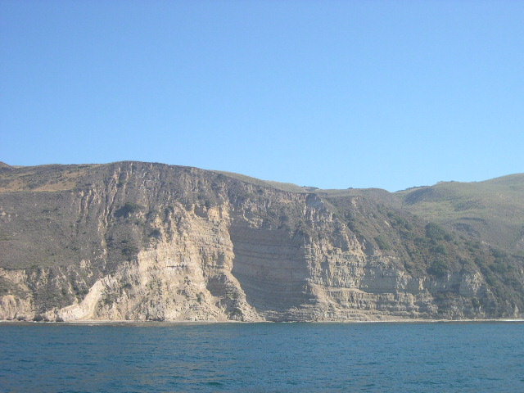
Weak rock folds easily
Notes:
Folding is especially common in the Monterey Shale because it a relatively weak rock. Since folding implies compression, …

Slide 62
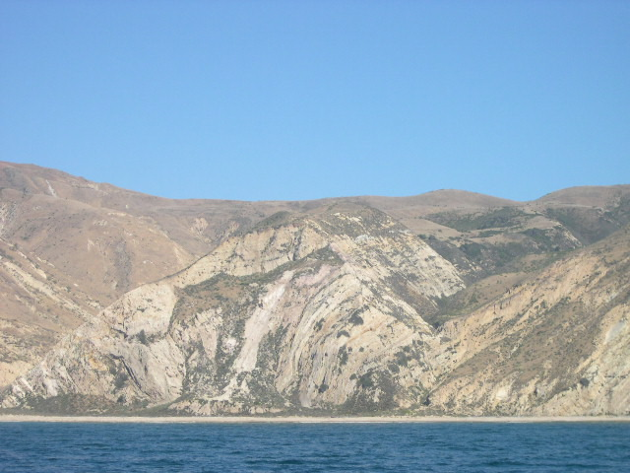
Transtension becomes Transtension
Notes:
… folds like this in the Monterey Shale highlight that transtensional basins may be subjected to transpression after they were filled with sediment.

Slide 63
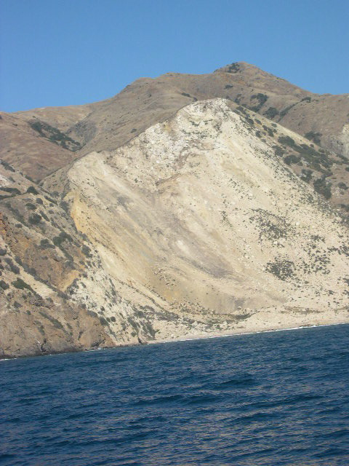
Landslide in Monterey Shale
Notes:
When folding tilts Monterey Shale layers toward the ocean, landslides are common because wave action can undermine the support holding the layers up. The Monterey Shale is notoriously unstable because the relatively common ash layers in the unit weather into a slippery type of clay that greatly reduces cohesion between layers.

Slide 64
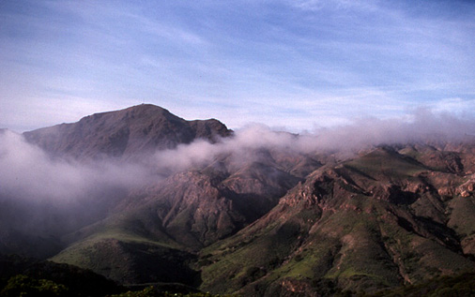
Resistant north side volcanic rocks
Notes:
Unlike the Monterey Shale, the volcanic rocks on the north side of Santa Cruz Island are much more resistant to erosion and mass wasting (landslides).

Slide 65
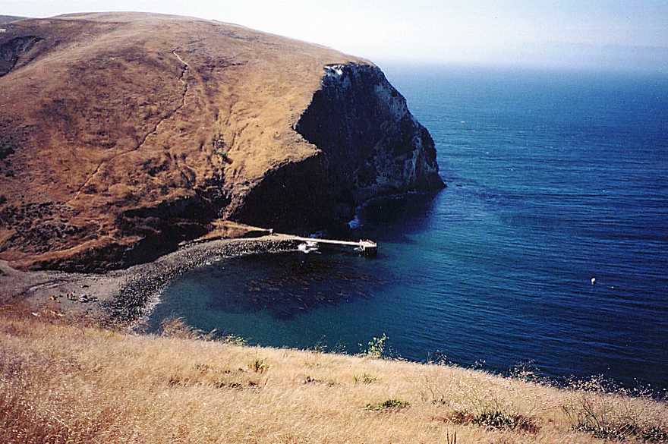
Resistant volcanics form sea cliffs and …
Scorpion Cove
Notes:
The resistant volcanics support shear sea cliffs, …

Slide 66
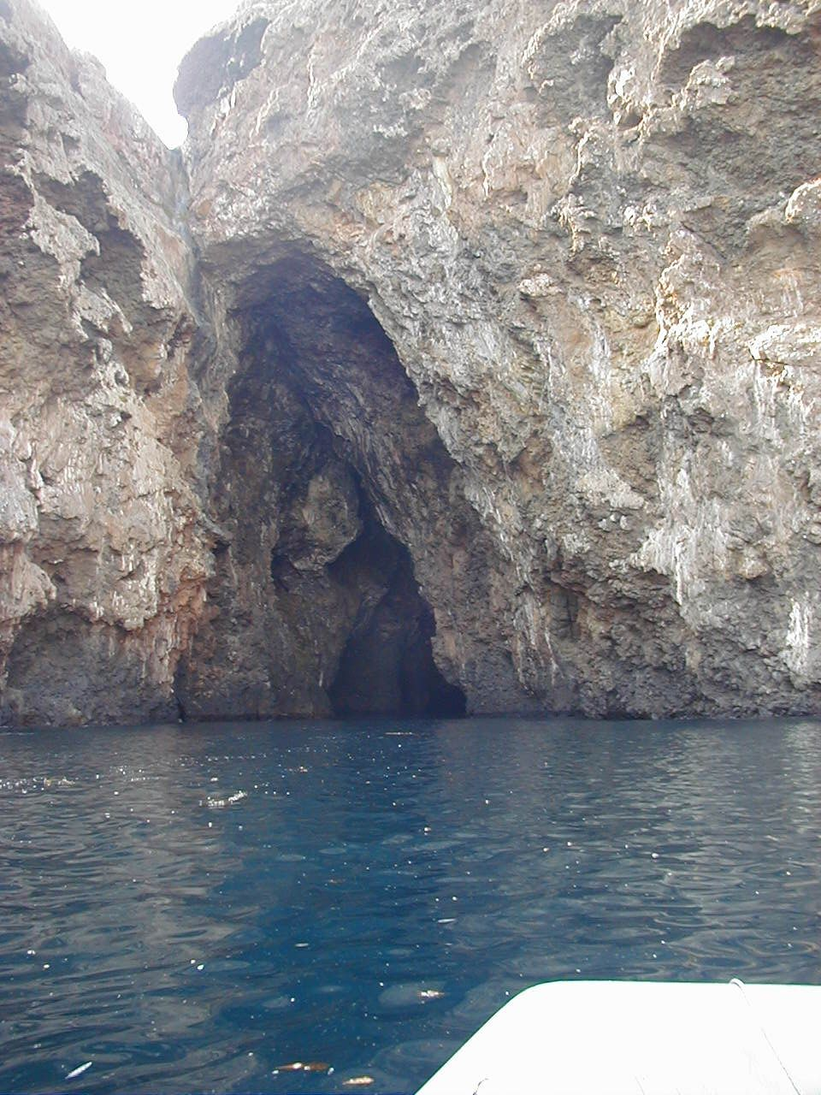
fault
Painted Cave
Notes:
… except where faulting has weakened the volcanics and promoted differential erosion by wave action. This is Painted Cave on the northwest shore of Santa Cruz Island.

Slide 67
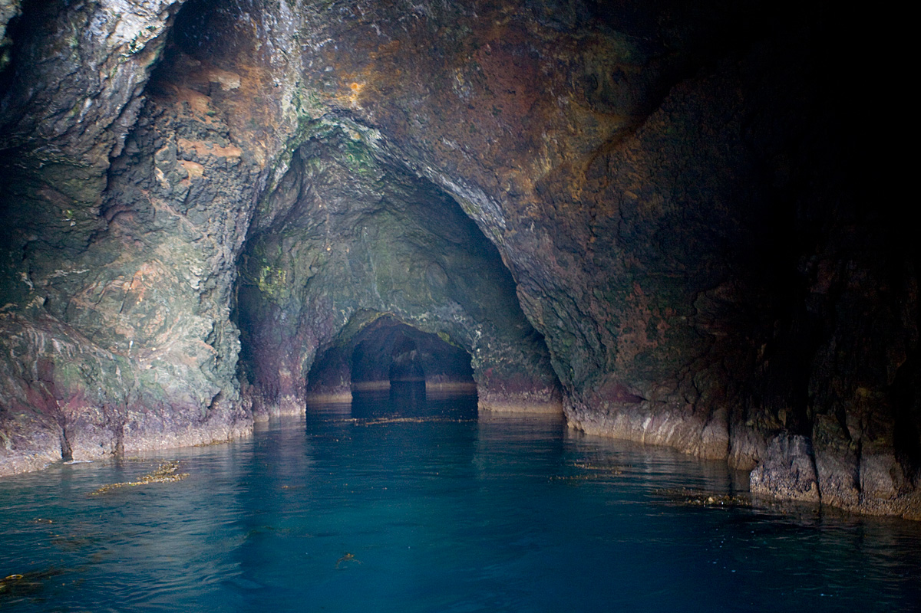
Notes:
Following the fault for almost a quarter of a mile, it’s the longest sea cave in the world!

Slide 68
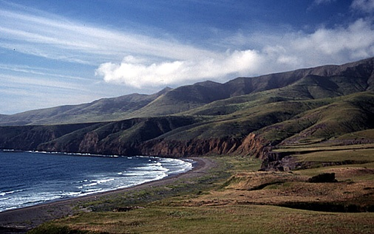
Marine terrace
Notes:
Above the volcanic cliffs, marine terraces are cut into many of the island’s peripheral slopes – a sure sign that the island is emergent.

